Slide 1


Coding the Collection:
Sprint 5 Final Demo
Team: Will Ye, Edward Zhuang, Sam Chan, Santo Grillo
Clients: Julia McHugh, Mark Olson

Slide 2

Demo
Notes:
SAM

Slide 3
User Testing Results
Positive
Quality of life changes can make big difference
“A lot has improved! ” - Julia McHugh
Critical
If people cannot quickly understand how to use application, they will not use it
Notes:
Clients and testers responded well to smaller changes in our application. Didn’t add much functionality this spring, but things like renaming labels, adding back button, made app much more enjoyable to use for our testers.
We learned that people can be quick to give up on an app. Saw in our user testing that a couple of testers struggled with earlier tasks, like creating an account, and didn’t even try to attempt latter ones. People don’t want to spend a ton of time learning how to use new software, and if it’s not intuitive from the get go, they will have a negative experience.
Share one thing each person learned during the semester from interacting with potential users.
Sam: definitely learned that as a developer, cannot assume users would know things that seem “intuitive” to us. This manifested itself in small ui/ux changes we’ve had to make throughout
Edward: learned that it’s always helpful to have additional perspectives/testing. Can help you resolve edge cases you never considered, even if you think you have meticulously tested the app.
Will: a lot of actions that are intuitive for us as devs aren't for users

Slide 4
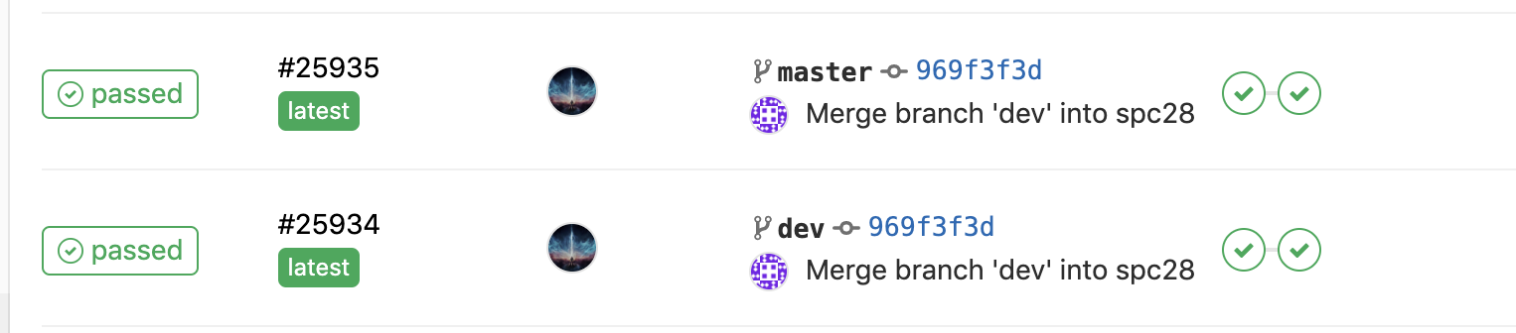
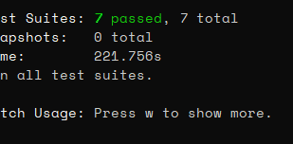
Testing Results
Comprehensive suite of unit tests
More automated CI tests
Notes:
WILL:
Demo the results from running your automated tests, showing Code Coverage results, and describe one manual test you do regularly as well as results from an Accessibility checking tool.
Share one thing each person learned or changed by testing their code regularly.
Sam: always looking out to how to create code that meets criteria and is written well, instead of the “easiest” way that may not be stable
Edward: learned about the value of ci/cd pipeline, found it an effective way to catch buggy code. Great returns for amount of work required to set it up. Only need to set it up at beginning, and it will impact all future potential merges.
Will: unit testing really helped automate a lot of the manual testing we used to do

Slide 5
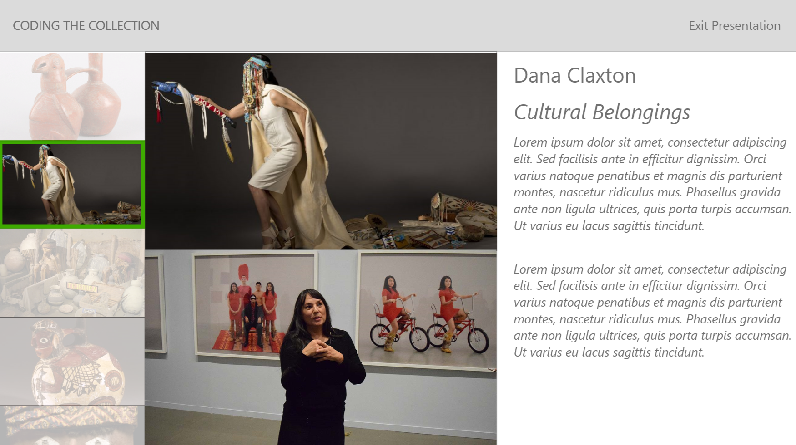
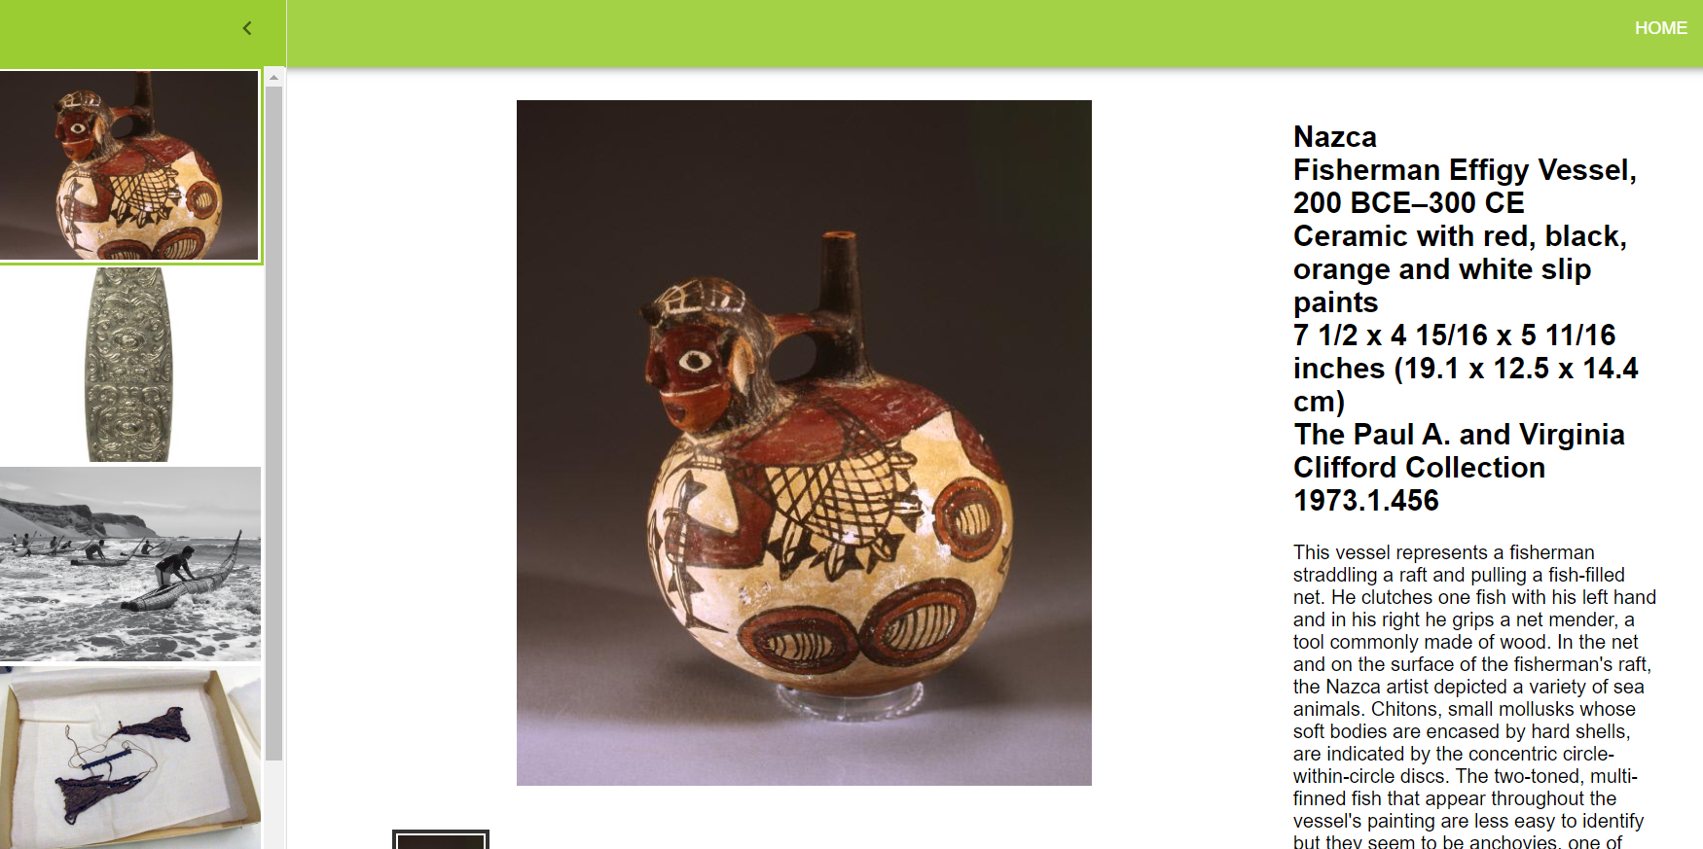
App Review
Project Plan:
Stretch goals (3D Models)
Set ambitious deadlines
Current App:
Functionality achieved, stylistic differences
Additional features like shared projects
Notes:
Edward: Beginning of semester, we had an idea of what app would look like now, but definitely have been some changes. Overall, proud with what we’ve accomplished. Able to incorporate all the general functionality we wanted to include, only stylistic differences. Even added additional features like shared projects. However, we weren’t able to hit stretch goals like 3D models, and we set ambitious deadlines.
Made app inclusive by preparing written instructions and video tutorial. Reduce negative potential outcomes by granting users specific privileges (ex. Cannot delete projects that are shared with them that you don’t own.)
Share one non-technical thing each person learned during the semester by working on your app or with your client.
Sam: Focus on delivering value to clients and getting minimal viable implementation constructed first.
Edward: Learned that path to success is never going to be perfect, will always be unplanned obstacles. However, just have to adapt to situation and learn from it.
Will: Often, our vision for the ap doesn't necessarily align with the vision of the clients

Slide 6
License Choice
MIT License
Open-source friendly
Widely used and commonplace
Little restrictions
Notes:
WILL: Explain which license your team and client agreed to for the app and why it was chosen

Slide 7
Timeline
Week 1
Meeting with Julia and user experience testing
Fix crucial bugs
Week 2
Bug fixes + UX Improvements
Presentation page upgrade
Notes:
SAM:
Show your Burndown chart and provide a brief timeline of significant events that occurred this Sprint and how communication was handled for each event (i.e., how each person was involved or learned about it later)
Share one thing each person learned or changed by trying to estimate and plan their work using tools, such as Issues and Milestones.
Sam: Using issues/milestones definitely helped keep me motivated as I could see the list of issues and the corresponding burndown chart, and it encouraged me to meet my goals early and not at the last second, so I could have time to debug and make sure my changes were stable.
Edward: By assigning issues different weights and practicing agile over several sprints, I learned how to become more comfortable estimating how long tasks will take. Now, I can use these planning skills for future projects.
Will: It's pretty difficult to come up with a perfect set of issues at the start of each spring — often, we had to split up issues or move them to next sprint

Slide 8
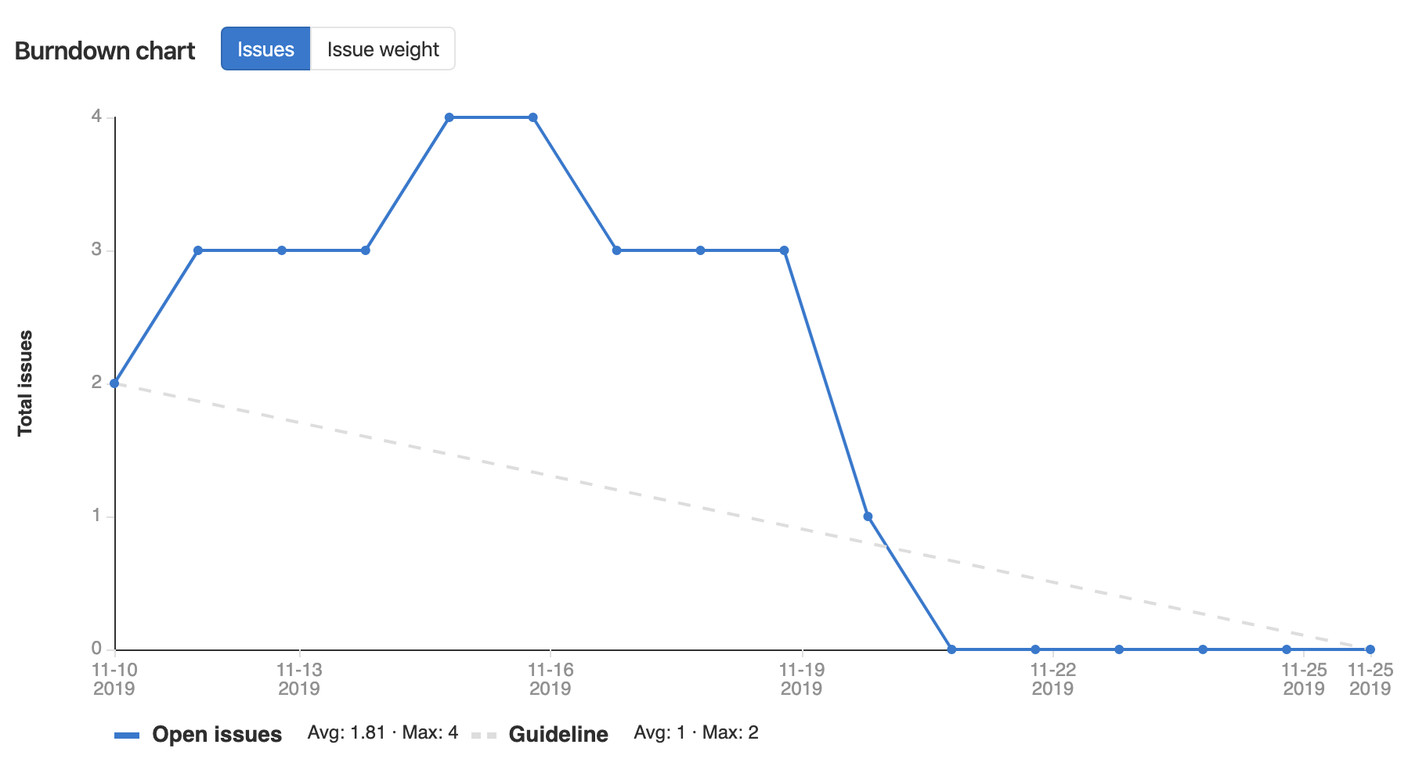
Burndown Chart
Notes:
SAM:
Show your Burndown chart and provide a brief timeline of significant events that occurred this Sprint and how communication was handled for each event (i.e., how each person was involved or learned about it later)
Share one thing each person learned or changed by trying to estimate and plan their work using tools, such as Issues and Milestones.

Slide 9
Retrospective
What worked:
Meeting with clients earlier
What did not work:
Planning to accomplish work during Thanksgiving break
One thing to improve:
Want to help each other more with difficult tasks/blockers
Notes:
EDWARD: one thing that worked, one thing that did not, and one concrete thing you plan to improve next Sprint about your teamwork/process and how you will determine whether or not actually improved
Meet earlier in Sprint - helped us make sure we were focusing on the important priorities during this sprint.
Planning to accomplish work during break - realized we all needed some time off from the project (and school), and it was unrealistic to assign work for that time period.
Want to help each other more with difficult tasks/blockers instead of letting people struggle with them individually, can measure this by counting how many times we help each other during a sprint, whether that’s big or small.
Share one thing each person learned or changed by using the Agile process to manage the coding process.
Sam: Definitely one thing I learned was the importance of communication--this means not only verbalizing how much work I have done or plan to do, but also whether I need help so my teammates can step in and help out, and same goes with my teammates as well.
Edward: Learned how important it is to review previous sprints to see what worked and what didn’t. Each future sprint is a chance to improve communication, productivity, and teamwork.
Will: having mini-demos within the team to show off what we accomplished was really helpful in letting the rest of the team know the current state of the project

Slide 10
Team Review
Most important way we improved:
Creating evenly-sized issues, dividing them among teammates, and finishing them on time
Something that can still be improved:
Communication
Notes:
WILL: most important way your team has improved during the semester and one thing that could still be improved.
Share one thing each person learned during the semester about creating a positive team culture.
Sam: Creating a positive team culture is just as important--or even more so--than just being knowledgeable and “smart,” because without the team culture of motivating each other, everyone will just slack off, but a good team environment really allows people to take personal ownership of their responsibilities
Edward: Learned that it’s not always easy to create a positive team culture - can be difficult thing to accomplish when everyone is busy and has other priorities. However, even though it requires effort, definitely worth it. Your productivity will improve, and it’s so much more enjoyable to work with a team you like.
Will: It's not enough to just communicate when you've completed something — having frequent status updates is really beneficial to keep everyone in the loop

Slide 11
Thanks for Listening!
Good luck on finals!

